Slide 1
平衡车仿真

Slide 2
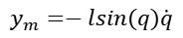
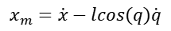
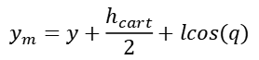
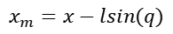
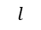
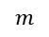
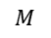

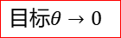
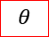
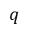
参考1：
$$m$$
倒立摆重物中心：
y
$$q$$
$$x_{m}=x−lsin(q)$$
$$θ$$
$$y_{m}=y+\frac{h_{cart}}{2}+lcos(q)$$
$$l$$
x
倒立摆重物速度：
z
$$M$$
$$F$$
$$x_{m}=\dot{x}−lcos(q)\dot{q}$$
目标$θ→0$
$$y_{m}=−lsin(q)\dot{q}$$

Slide 3
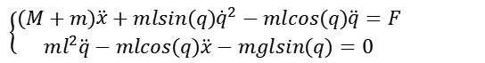
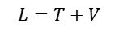
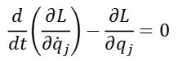
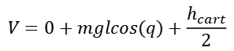
$$T=\frac{1}{2}(M+m){\dot{x}}^{2}+\frac{1}{2}ml^{2}−mlcos(q)\dot{q}\dot{x}$$
总动能：
$$m$$
$$T=\frac{1}{2}M{\dot{x}}^{2}+\frac{1}{2}m[{(\dot{x}−lcos(q)\dot{q})}^{2}+{(−lsin(q)\dot{q})}^{2}]$$
$$q$$
总势能：
$$V=0+mglcos(q)+\frac{h_{cart}}{2}$$
$$l$$
拉格朗日方程：
$$L=T+V$$
$$M$$
$$F$$
$$\frac{d}{dt}\left(\frac{∂L}{∂{\dot{q}}_{j}}\right)−\frac{∂L}{∂q_{j}}=0$$
$$\left\{\begin{aligned}(M+m)\ddot{x}+mlsin(q){\dot{q}}^{2}−mlcos(q)\ddot{q}=F \\ ml^{2}\ddot{q}−mlcos(q)\ddot{x}−mglsin(q)=0\end{aligned}\right.$$

Slide 4
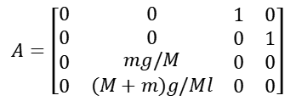
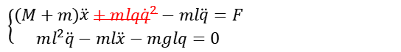
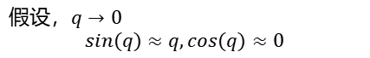
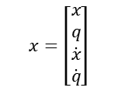
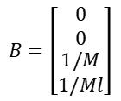
$$\left\{\begin{aligned}(M+m)\ddot{x}+mlsin(q){\dot{q}}^{2}−mlcos(q)\ddot{q}=F \\ ml^{2}\ddot{q}−mlcos(q)\ddot{x}−mglsin(q)=0\end{aligned}\right.$$
$$m$$
假设，$q→0$ $$sin(q)≈q,cos(q)≈0$$
$$q$$
$$l$$
$$\left\{\begin{aligned}(M+m)\ddot{x}+mlq{\dot{q}}^{2}−ml\ddot{q}=F \\ ml^{2}\ddot{q}−ml\ddot{x}−mglq=0\end{aligned}\right.$$
$$x=\left[\begin{matrix}x \\ q \\ \begin{matrix}\dot{x} \\ \dot{q}\end{matrix}\end{matrix}\right]$$
$$M$$
$$F$$
$$A=\left[\begin{matrix}0 & 0 & \begin{matrix}1 & 0\end{matrix} \\ 0 & 0 & \begin{matrix}0 & 1\end{matrix} \\ \begin{matrix}0 \\ 0\end{matrix} & \begin{matrix}mg/M \\ (M+m)g/Ml\end{matrix} & \begin{matrix}\begin{matrix}0 & 0\end{matrix} \\ \begin{matrix}0 & 0\end{matrix}\end{matrix}\end{matrix}\right]$$
$$B=\left[\begin{matrix}0 \\ 0 \\ \begin{matrix}1/M \\ 1/Ml\end{matrix}\end{matrix}\right]$$

Slide 5
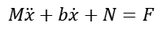
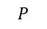
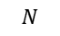
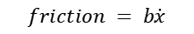
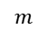
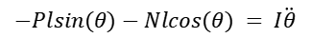
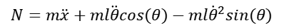
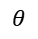
参考2：
对车：
$$P$$
$$M\ddot{x}+b\dot{x}+N=F$$
$$l$$
对杆子：
$$m$$
$$N=m\ddot{x}+ml\ddot{θ}cos(θ)−ml{\dot{θ}}^{2}sin(θ)$$
$$θ$$
$$N$$
第一动力学方程：
$$N$$
$$(M+m)\ddot{x}+b\dot{x}+ml\ddot{θ}cos(θ)−ml{\dot{θ}}^{2}sin(θ)=F$$
$$F$$
$$M$$
$$friction = b\dot{x}$$
对杆子垂直方向：
$$P$$
$$Psin(θ)+Ncos(θ)−mgsin(θ) = ml\ddot{θ}+m\ddot{x}cos(θ)$$
对杆子扭力：
$$−Plsin(θ)−Nlcos(θ) = I\ddot{θ}$$
第二动力学方程：
$$(I+ml^{2})\ddot{θ}+mgsin(θ) = −ml\ddot{x}cos(θ)$$

Slide 6
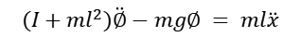
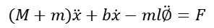
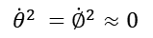
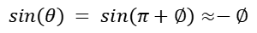
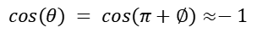
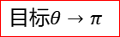

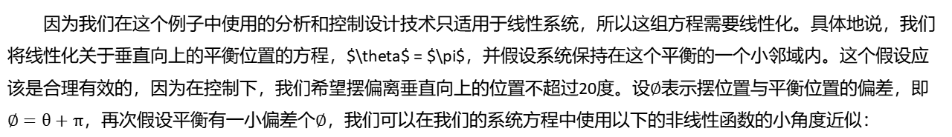
因为我们在这个例子中使用的分析和控制设计技术只适用于线性系统，所以这组方程需要线性化。具体地说，我们将线性化关于垂直向上的平衡位置的方程，$\theta$ = $\pi$，并假设系统保持在这个平衡的一个小邻域内。这个假设应该是合理有效的，因为在控制下，我们希望摆偏离垂直向上的位置不超过20度。设$∅$表示摆位置与平衡位置的偏差，即$∅=θ+π$，再次假设平衡有一小偏差个$∅$，我们可以在我们的系统方程中使用以下的非线性函数的小角度近似：
$$cos(θ) = cos(π+∅)≈−1$$
$$P$$
$$l$$
$$sin(θ) = sin(π+∅)≈−∅$$
$$m$$
$${\dot{θ}}^{2} ={\dot{∅}}^{2}≈0$$
$$θ$$
$$N$$
$$N$$
第一动力学方程：
y
$$F$$
$$M$$
$$friction = b\dot{x}$$
$$(M+m)\ddot{x}+b\dot{x}−ml\ddot{∅}=F$$
$$P$$
第二动力学方程：
$$(I+ml^{2})\ddot{∅}−mg∅ = ml\ddot{x}$$
$$θ$$
x
z
目标$θ→π$

Slide 7

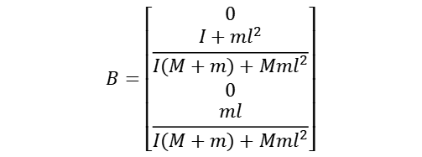
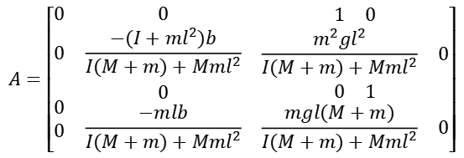
$$A=\left[\begin{matrix}0 & 0 & \begin{matrix}1 & 0\end{matrix} \\ 0 & \frac{−(I+ml^{2})b}{I(M+m)+Mml^{2}} & \begin{matrix}\frac{m^{2}gl^{2}}{I(M+m)+Mml^{2}} & 0\end{matrix} \\ \begin{matrix}0 \\ 0\end{matrix} & \begin{matrix}0 \\ \frac{−mlb}{I(M+m)+Mml^{2}}\end{matrix} & \begin{matrix}\begin{matrix}0 & 1\end{matrix} \\ \begin{matrix}\frac{mgl(M+m)}{I(M+m)+Mml^{2}} & 0\end{matrix}\end{matrix}\end{matrix}\right]$$
$$B=\left[\begin{matrix}0 \\ \frac{I+ml^{2}}{I(M+m)+Mml^{2}} \\ \begin{matrix}0 \\ \frac{ml}{I(M+m)+Mml^{2}}\end{matrix}\end{matrix}\right]$$
$$x=\left[\begin{matrix}x \\ \dot{x} \\ \begin{matrix}∅ \\ \dot{∅}\end{matrix}\end{matrix}\right]$$

Slide 8
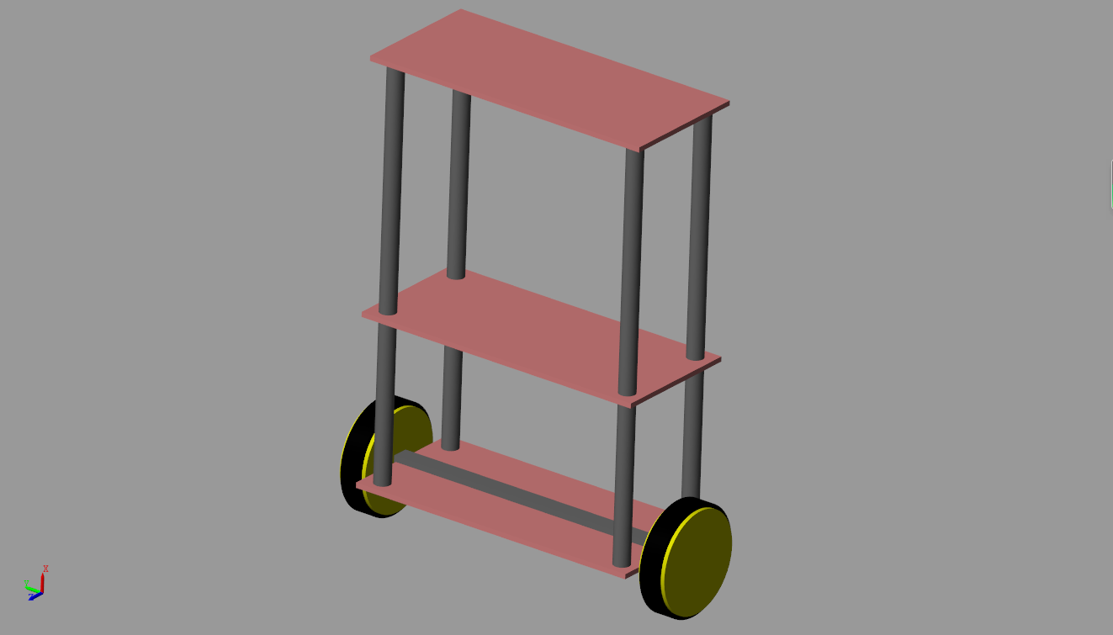
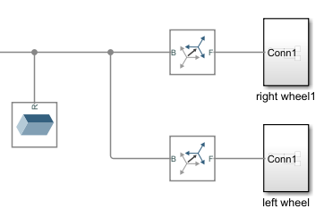

Slide 9
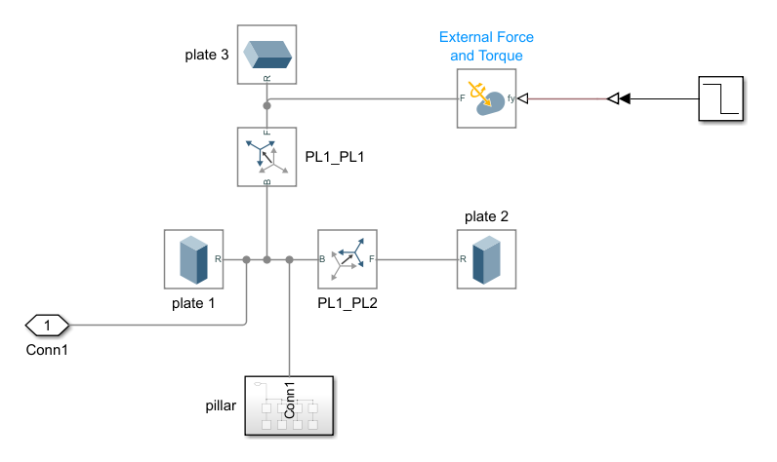

Slide 10
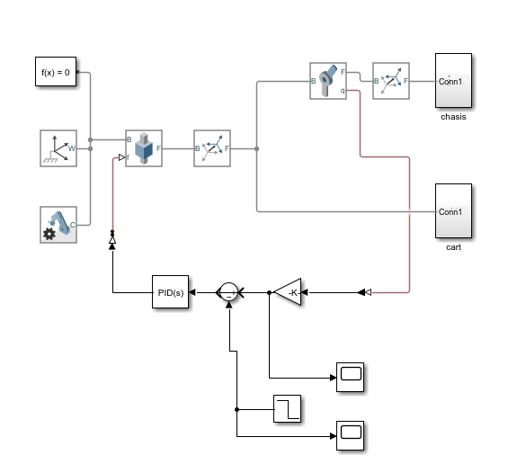

Slide 11
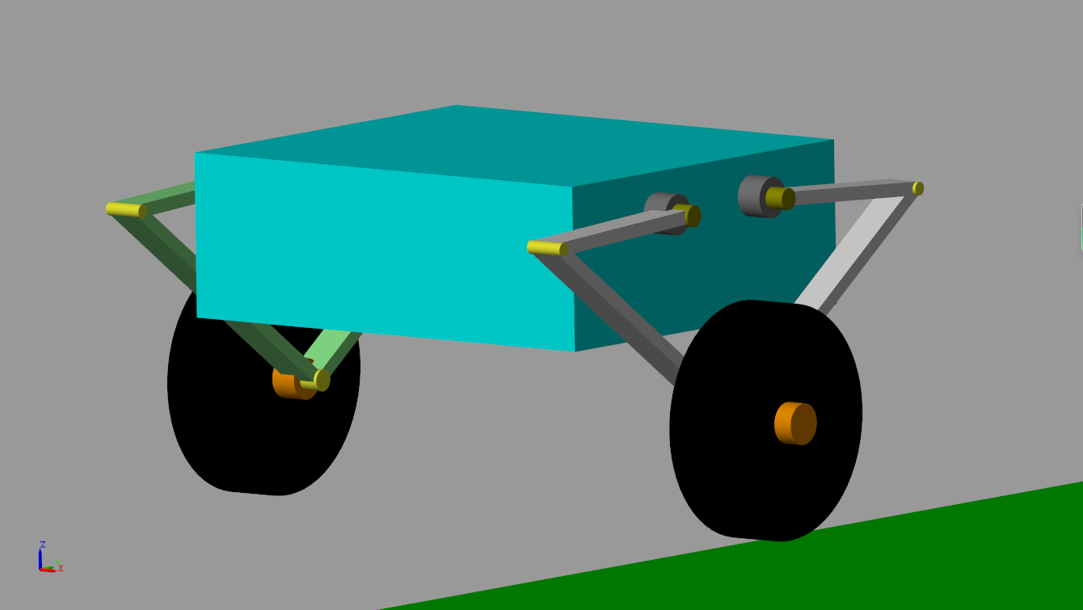
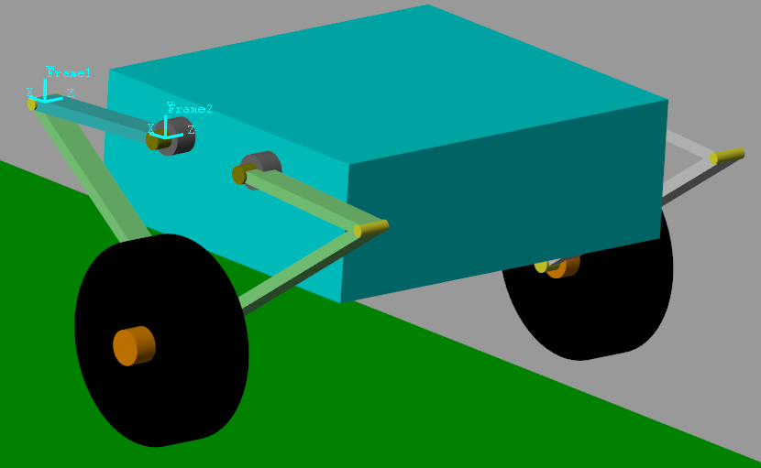
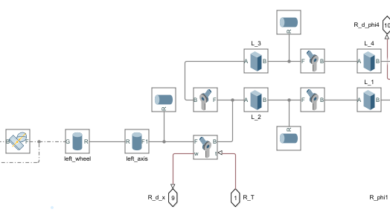

Slide 12
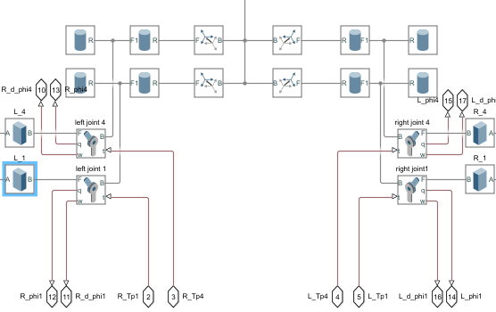

Slide 13
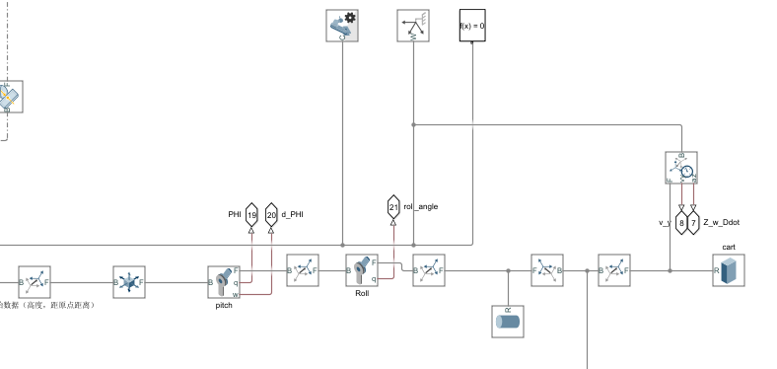
内部管子

Slide 14
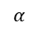
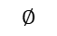
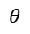
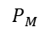
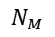







一、倒立摆建模
$$P_{M}$$
R：驱动轮半径
L：摆杆中心到驱动轮轴距离
$L_{M}$：摆杆重心到机体转轴距离
l：机体重心到转轴距离
$m_{M}$：驱动轮转子质量
$m_{p}$：摆杆质量
M ：机体质量
$I_{w}$：驱动轮转动惯量
$I_{p}$：摆杆转动惯量
$I_{M}$：机体转动惯量
$$l$$
$$∅$$
$$α$$
$$N_{M}$$
$$L_{M}$$
P
$$θ$$
$$L$$
N
$$θ由−∞→0$$
R
$$N_{f}$$
$$∅由−∞→−\frac{π}{2}$$

Slide 15


对轮子：
力：
$$m_{w}\ddot{x}=N_{f}−N$$
P
扭力：
$$I_{w}\ddot{\frac{x}{R}}=T−N_{f}R$$
N
R
$$N_{f}$$

Slide 16



对摆杆：
$$P_{M}$$
力：
$$m_{p}\frac{∂}{∂t^{2}}(x + Lsinθ)=N−N_{M}$$
$$m_{p}\frac{∂}{∂t^{2}}(Lcosθ)=P−P_{M}−m_{p}g$$
$$l$$
$$∅$$
$$α$$
$$N_{M}$$
$$L_{M}$$
P
扭力：
$$m_{p}g$$
$$θ$$
$$L$$
$$I_{p}\ddot{θ}=(PL+P_{M}L_{M})sinθ−(NL+N_{M}L_{M})cosθ−T+T_{p}$$
N

Slide 17



对机体：
$$P_{M}$$
力：
$$m_{p}\frac{∂}{∂t^{2}}(x + (L+L_{M})sinθ − lsin∅)=N_{M}$$
$$m_{p}\frac{∂}{∂t^{2}}((L+L_{M})cosθ + lcos∅)=P_{M}−Mg$$
$$l$$
$$∅$$
$$α$$
$$N_{M}$$
扭力：
$$I_{M}\ddot{∅}=P_{M}lsin∅+N_{M}lcos∅ +T_{p}$$

Slide 18








非线性系统：
y
y
$$x=\left[\begin{matrix}x \\ \dot{x} \\ \begin{matrix}θ \\ \dot{θ} \\ \begin{matrix}∅ \\ \dot{∅}\end{matrix}\end{matrix}\end{matrix}\right],u=\left[\begin{matrix}T \\ T_{p}\end{matrix}\right]$$
$$θ$$
$$\dot{x} =f (x,u)$$
$$\ddot{x}=\frac{T−NR}{\frac{I_{w}}{R}+m_{w}R}$$
x
$$θ$$
x
$$m_{w}\ddot{x}=N_{f}−N$$
$$I_{w}\ddot{\frac{x}{R}}=T−N_{f}R$$
z
z
目标$θ→π$
目标$θ→0$
$$m_{p}\frac{∂}{∂t^{2}}(x + Lsinθ)=N−N_{M}=m_{p}(\ddot{x}+Lcosθ\ddot{θ}−Lsinθ{\dot{θ}}^{2})$$
$$m_{p}\frac{∂}{∂t^{2}}(Lcosθ)=P−P_{M}−m_{p}g=m_{p}(−Lsinθ\ddot{θ}−Lcosθ{\dot{θ}}^{2})$$
$$I_{p}\ddot{θ}=(PL+P_{M}L_{M})sinθ−(NL+N_{M}L_{M})cosθ−T+T_{p}$$
$$m_{p}\frac{∂}{∂t^{2}}(x + (L+L_{M})sinθ − lsin∅)=N_{M}=m_{p}(\ddot{x}+lsin∅{\dot{∅}}^{2}−lcos∅\ddot{∅}−sinθ{\dot{θ}}^{2}(L+L_{M})+cosθ\ddot{θ}(L+L_{M}))$$
$$m_{p}\frac{∂}{∂t^{2}}((L+L_{M})cosθ + lcos∅)=P_{M}−Mg=m_{p}(−lcos∅{\dot{∅}}^{2}−lsin∅\ddot{∅}−(L+L_{M})cosθ{\dot{θ}}^{2}−(L+L_{M})sinθ\ddot{θ})$$
$$I_{M}\ddot{∅}=P_{M}lsin∅+N_{M}lcos∅ +T_{p}$$

Slide 19


第一动力学方程
$$\ddot{x}=\frac{T−(m_{p}(\ddot{x}+Lcosθ\ddot{θ}−Lsinθ{\dot{θ}}^{2}) +m_{p}(\ddot{x}+lsin∅{\dot{∅}}^{2}−lcos∅\ddot{∅}−sinθ{\dot{θ}}^{2}(L+L_{M})+cosθ\ddot{θ}(L+L_{M})))R}{\frac{I_{w}}{R}+m_{w}R}$$
第二动力学方程
$$I_{p}\ddot{θ}=((m_{p}(−lcos∅{\dot{∅}}^{2}−lsin∅\ddot{∅}−(L+L_{M})cosθ{\dot{θ}}^{2}−(L+L_{M})sinθ\ddot{θ})+Mg+m_{p}g+m_{p}(−Lsinθ\ddot{θ}−Lcosθ{\dot{θ}}^{2}))L+(m_{p}(−lcos∅{\dot{∅}}^{2}−lsin∅\ddot{∅}−(L+L_{M})cosθ{\dot{θ}}^{2}−(L+L_{M})sinθ\ddot{θ})$$
$$+Mg)L_{M})sinθ−((m_{p}(\ddot{x}+lsin∅{\dot{∅}}^{2}−lcos∅\ddot{∅}−sinθ{\dot{θ}}^{2}(L+L_{M})+cosθ\ddot{θ}(L+L_{M}))))L+(m_{p}(\ddot{x}+lsin∅{\dot{∅}}^{2}−lcos∅\ddot{∅}−sinθ{\dot{θ}}^{2}(L+L_{M})+cosθ\ddot{θ}(L+L_{M})) )L_{M})cosθ−T+T_{p}$$
第三动力学方程
$$I_{M}\ddot{∅}=(m_{p}(−lcos∅{\dot{∅}}^{2}−lsin∅\ddot{∅}−(L+L_{M})cosθ{\dot{θ}}^{2}−(L+L_{M})sinθ\ddot{θ})$$
$$+Mg)lsin∅+(m_{p}(\ddot{x}+lsin∅{\dot{∅}}^{2}−lcos∅\ddot{∅}−sinθ{\dot{θ}}^{2}(L+L_{M})+cosθ\ddot{θ}(L+L_{M}))$$
$$)lcos∅ +T_{p}$$

Slide 20







$$θ由−∞→0$$
$$sin(θ)≈−θ$$
$$cos(θ)≈1$$
$$∅由−∞→−\frac{π}{2}$$
$$sin(∅)≈−1$$
$$cos(∅)≈−∅$$
第一动力学方程
$$\ddot{x}=\frac{T−(m_{p}(\ddot{x}+L\ddot{θ}) +m_{p}(\ddot{x}+l∅\ddot{∅}+\ddot{θ}(L+L_{M})))R}{\frac{I_{w}}{R}+m_{w}R}$$
第二动力学方程
$$I_{p}\ddot{θ}=((m_{p}(l∅\ddot{∅}+(L+L_{M})θ\ddot{θ})+Mg+m_{p}g+m_{p}Lθ\ddot{θ})L+(m_{p}(l∅{\dot{∅}}^{2}+l\ddot{∅}−(L+L_{M}){\dot{θ}}^{2}+(L+L_{M})θ\ddot{θ})+Mg)L_{M})sinθ−((m_{p}(\ddot{x}+l∅\ddot{∅}+\ddot{θ}(L+L_{M}))))L+(m_{p}(\ddot{x}+l∅\ddot{∅}+\ddot{θ}(L+L_{M})) )L_{M})−T+T_{p}$$
第三动力学方程
$$I_{M}\ddot{∅}=−(m_{p}(l∅{\dot{∅}}^{2}+l\ddot{∅}+(L+L_{M})θ\ddot{θ})+Mg)l−(m_{p}(\ddot{x}−l{\dot{∅}}^{2}+l∅\ddot{∅}+θ{\dot{θ}}^{2}(L+L_{M})+\ddot{θ}(L+L_{M})))l∅ +T_{p}$$

Slide 21







$$θ由−∞→0$$
$$sin(θ)≈−θ$$
$$cos(θ)≈1$$
$$\ddot{x}=\frac{T−NR}{\frac{I_{w}}{R}+m_{w}R}$$
$$∅由−∞→−\frac{π}{2}$$
$$sin(∅)≈−1$$
$$cos(∅)≈−∅$$
$$N−N_{M}=m_{p}(\ddot{x}+L\ddot{θ})$$
$$P−P_{M}−m_{p}g=m_{p}(Lθ\ddot{θ})$$
$$I_{p}\ddot{θ}=−(PL+P_{M}L_{M})θ−(NL+N_{M}L_{M})−T+T_{p}$$
$$N_{M}=m_{p}(\ddot{x}+l∅\ddot{∅}+\ddot{θ}(L+L_{M}))$$
$$P_{M}−Mg=m_{p}(l\ddot{∅}+(L+L_{M})θ\ddot{θ})$$
$$I_{M}\ddot{∅}=−P_{M}l−N_{M}l∅ +T_{p}$$

Slide 22



y
y
y
$$θ$$
$$P_{M}$$
$$θ$$
x
$$θ$$
x
x
$$∅$$
z
z
z
$$N_{M}$$
目标$θ→0$
目标$θ→π+∅$
目标$θ→\frac{π}{2}+∅$
$$L_{M}$$
y
P
$$m_{p}g$$
$$θ$$
$$L$$
$$θ$$
x
z
N
目标$θ→0$

Slide 23


查看角度变化规律
$$P_{M}$$
$$P_{M}$$
$$P_{M}$$
$$P_{M}$$
$$∅$$
$$∅$$
$$∅$$
$$l$$
$$∅$$
$$α$$
$$N_{M}$$
$$N_{M}$$
$$N_{M}$$
$$N_{M}$$
$$L_{M}$$
$$L_{M}$$
$$L_{M}$$
$$L_{M}$$
P
P
P
P
$$θ$$
$$L$$
$$m_{p}g$$
$$m_{p}g$$
$$m_{p}g$$
$$L$$
$$θ$$
$$L$$
$$θ$$
$$L$$
$$θ$$
N
R
N
N
N
$$N_{f}$$

Slide 24
对轮子：
$$P_{M}$$
力：
$$m_{w}\ddot{x}=N_{f}−N$$
$$∅$$
$$N_{M}$$
$$L_{M}$$
扭力：
P
$$m_{p}g$$
$$I_{w}\ddot{\frac{x}{R}}=T−N_{f}R$$
$$L$$
$$θ$$
N

Slide 25
对摆杆：
$$P_{M}$$
力：
$$m_{p}\frac{∂}{∂t^{2}}(x + Lsinθ)=N−N_{M}$$
$$∅$$
$$m_{p}\frac{∂}{∂t^{2}}(Lcosθ)=P−P_{M}−m_{p}g$$
$$N_{M}$$
$$L_{M}$$
扭力：
P
$$m_{p}g$$
$$I_{p}\ddot{θ}=(PL+P_{M}L_{M})sinθ−(NL+N_{M}L_{M})cosθ−T+T_{p}$$
$$L$$
$$θ$$
N

Slide 26




对机体：
$$P_{M}$$
力：
$$m_{p}\frac{∂}{∂t^{2}}(x + (L+L_{M})sinθ + lsin∅)=N_{M}$$
$$∅$$
$$m_{p}\frac{∂}{∂t^{2}}((L+L_{M})cosθ + lcos∅)=P_{M}−Mg$$
$$l$$
$$N_{M}$$
$$L_{M}$$
扭力：
P
$$m_{p}g$$
$$I_{M}\ddot{∅}=−P_{M}lsin∅+N_{M}lcos∅ +T_{p}$$
$$L$$
$$θ$$
N

Slide 27


非线性系统方程：
$$m_{w}\ddot{x}=N_{f}−N$$
$$\ddot{x}=\frac{T−NR}{\frac{I_{w}}{R}+m_{w}R}$$
$$θ→0,sinθ≈θ,cosθ≈0$$
$$∅→0,sin∅≈∅,cos∅≈0$$
$$I_{w}\ddot{\frac{x}{R}}=T−N_{f}R$$
$$m_{p}\frac{∂}{∂t^{2}}(x + Lsinθ)=N−N_{M}=m_{p}(\ddot{x}+Lcosθ\ddot{θ}−Lsinθ{\dot{θ}}^{2})=m_{p}(\ddot{x}+L\ddot{θ})$$
$$m_{p}\frac{∂}{∂t^{2}}(Lcosθ)=P−P_{M}−m_{p}g=m_{p}(−Lsinθ\ddot{θ}−Lcosθ{\dot{θ}}^{2})=m_{p}(−Lθ\ddot{θ})$$
$$I_{p}\ddot{θ}=(PL+P_{M}L_{M})sinθ−(NL+N_{M}L_{M})cosθ−T+T_{p}=(PL+P_{M}L_{M})θ−(NL+N_{M}L_{M})−T+T_{p}$$
$$m_{p}\frac{∂}{∂t^{2}}(x + (L+L_{M})sinθ + lsin∅)=N_{M}=m_{p}(\ddot{x}−lsin∅{\dot{∅}}^{2}+lcos∅\ddot{∅}−sinθ{\dot{θ}}^{2}(L+L_{M})+cosθ\ddot{θ}(L+L_{M}))=m_{p}(\ddot{x}+l\ddot{∅}+\ddot{θ}(L+L_{M}))$$
$$m_{p}\frac{∂}{∂t^{2}}((L+L_{M})cosθ + lcos∅)=P_{M}−Mg=m_{p}(−lcos∅{\dot{∅}}^{2}−lsin∅\ddot{∅}−(L+L_{M})cosθ{\dot{θ}}^{2}−(L+L_{M})sinθ\ddot{θ})=m_{p}(−l∅\ddot{∅}−(L+L_{M})θ\ddot{θ})$$
$$I_{M}\ddot{∅}=−P_{M}lsin∅+N_{M}lcos∅ +T_{p}=−P_{M}l∅+N_{M}l +T_{p}$$

Slide 28






$$\frac{d\ddot{x}}{dx}=0$$
$$\frac{d\ddot{x}}{dθ}=(L^{2}R^{2}gl^{2}{m_{p}}^{3}−2I_{M}L^{2}R^{2}g{m_{p}}^{2}+L^{2}MR^{2}gl^{2}{m_{p}}^{2}−I_{M}LL_{M}R^{2}g{m_{p}}^{2}−2I_{M}L^{2}MR^{2}gm_{p}−I_{M}{L_{M}}^{2}MR^{2}gm_{p}−3I_{M}LL_{M}MR^{2}gm_{p}+LL_{M}MR^{2}gl^{2}{m_{p}}^{2})/(−m_{w}L^{2}R^{2}l^{2}{m_{p}}^{2}+2I_{M}m_{w}L^{2}R^{2}m_{p}−I_{w}L^{2}l^{2}{m_{p}}^{2}+2I_{M}I_{w}L^{2}m_{p}+2I_{w}m_{w}LL_{M}R^{2}m_{p}+2I_{M}I_{w}LL_{M}m_{p}+I_{M}{L_{M}}^{2}R^{2}{m_{p}}^{2}+I_{M}m_{w}{L_{M}}^{2}R^{2}m_{p}+I_{M}I_{w}{L_{M}}^{2}m_{p}−I_{p}R^{2}l^{2}{m_{p}}^{2}−I_{p}m_{w}R^{2}l^{2}m_{p}+2I_{M}I_{p}R^{2}m_{p}+I_{M}I_{p}m_{w}R^{2}−I_{p}I_{w}lm_{p}+I_{M}I_{p}I_{w})$$
$$\frac{d\ddot{x}}{d∅}=(I_{p}MR^{2}gl^{2}m_{p}−LL_{M}MR^{2}gl^{2}{m_{p}}^{2})/(−m_{w}L^{2}R^{2}l^{2}{m_{p}}^{2}+2I_{M}m_{w}L^{2}R^{2}m_{p}−I_{w}L^{2}l^{2}{m_{p}}^{2}+2I_{M}I_{w}L^{2}m_{p}+2I_{M}m_{w}LL_{M}R^{2}m_{p}+2I_{M}I_{w}LL_{M}m_{p}+I_{M}{L_{M}}^{2}R^{2}{m_{p}}^{2}+I_{M}m_{w}{L_{M}}^{2}R^{2}m_{p}+I_{M}I_{w}{L_{M}}^{2}m_{p}−I_{p}R^{2}l^{2}{m_{p}}^{2}−I_{p}m_{w}R^{2}l^{2}m_{p}+2I_{M}I_{p}R^{2}m_{p}+I_{M}I_{p}m_{w}R^{2}−I_{p}I_{w}l^{2}m_{p}+I_{M}I_{p}I_{w})$$
$$\frac{d\ddot{x}}{d\dot{x}}=0$$
$$\frac{d\ddot{x}}{d\dot{θ}}=0$$
$$\frac{d\ddot{x}}{d\dot{∅}}=0$$

Slide 29






$$\frac{d\ddot{θ}}{dx}=0$$
$$\frac{d\ddot{θ}}{dθ}= −(LR^{2}gl^{2}{m_{p}}^{3}−I_{M}I_{w}Lgm_{p}−2I_{M}LR^{2}g{m_{p}}^{2}−I_{M}I_{w}LMg−I_{M}I_{w}L_{M}Mg+I_{w}Lgl^{2}{m_{p}}^{2}+LMR^{2}gl^{2}{m_{p}}^{2}+L_{M}MR^{2}gl^{2}{m_{p}}^{2}−2I_{M}LMR^{2}gm_{p}−I_{M}LMR^{2}gm_{w}−2I_{M}L_{M}MR^{2}gm_{p}−I_{M}L_{M}MR^{2}gm_{w}+LR^{2}gl^{2}{m_{p}}^{2}m_{w}+I_{w}LMgl^{2}m_{p}+I_{w}L_{M}Mgl^{2}m_{p}−I_{M}LR^{2}gm_{p}m_{w}+LMR^{2}gl^{2}m_{p}m_{w}+L_{M}MR^{2}gl^{2}m_{p}m_{w})/(−m_{w}L^{2}R^{2}l^{2}{m_{p}}^{2}+2I_{M}m_{w}L^{2}R^{2}m_{p}−I_{w}L^{2}l^{2}{m_{p}}^{2}+2I_{M}I_{w}L^{2}m_{p}+2I_{M}m_{w}LL_{M}R^{2}m_{p}+2I_{M}I_{w}LL_{M}m_{p}+I_{M}{L_{M}}^{2}R^{2}{m_{p}}^{2}+I_{M}m_{w}{L_{M}}^{2}R^{2}m_{p}+I_{M}I_{w}{L_{M}}^{2}m_{p}−I_{p}R^{2}l^{2}{m_{p}}^{2}−I_{p}m_{w}R^{2}l^{2}m_{p}+2I_{M}I_{p}R^{2}m_{p}+I_{M}I_{p}m_{w}R^{2}−I_{p}I_{w}l^{2}m_{p}+I_{M}I_{p}I_{w})$$
$$\frac{d\ddot{θ}}{d∅}=−(−L_{M}MR^{2}gl^{2}{m_{p}}^{2}−I_{w}LMgl^{2}m_{p}−I_{w}L_{M}Mgl^{2}m_{p}−LMR^{2}gl^{2}m_{p}m_{w}−L_{M}MR^{2}gl^{2}m_{p}m_{w})/(−m_{w}L^{2}R^{2}l^{2}{m_{p}}^{2}+2I_{M}m_{w}L^{2}R^{2}m_{p}−I_{w}L^{2}l^{2}{m_{p}}^{2}+2I_{M}I_{w}L^{2}m_{p}+2I_{M}m_{w}LL_{M}R^{2}m_{p}+2I_{M}I_{w}LL_{M}m_{p}+I_{M}{L_{M}}^{2}R^{2}{m_{p}}^{2}+I_{M}m_{w}{L_{M}}^{2}R^{2}m_{p}+I_{M}I_{w}{L_{M}}^{2}m_{p}−I_{p}R^{2}l^{2}{m_{p}}^{2}−I_{p}m_{w}R^{2}l^{2}m_{p}+2I_{M}I_{p}R^{2}m_{p}+I_{M}I_{p}m_{w}R^{2}−I_{p}I_{w}l^{2}m_{p}+I_{M}I_{p}I_{w})$$
$$\frac{d\ddot{θ}}{d\dot{x}}=0$$
$$\frac{d\ddot{θ}}{d\dot{θ}}=0$$
$$\frac{d\ddot{θ}}{d\dot{∅}}=0$$

Slide 30






$$\frac{d\ddot{∅}}{dx}=0$$
$$\frac{d\ddot{∅}}{dθ}=(I_{w}L^{2}gl{m_{p}}^{2}+LL_{M}R^{2}gl{m_{p}}^{3}+{L_{M}}^{2}MR^{2}gl{m_{p}}^{2}+L^{2}R^{2}gl{m_{p}}^{2}m_{w}+I_{w}LL_{M}gl {m_{p}}^{2}+I_{w}L^{2}Mglm_{p}+I_{w}{L_{M}}^{2}Mglm_{p}+LL_{M}MR^{2}gl{m_{p}}^{2}+LL_{M}R^{2}gl{m_{p}}^{2}m_{w}+L^{2}MR^{2}glm_{p}m_{w}+{L_{M}}^{2}MR^{2}glm_{p}m_{w}+2I_{w}LL_{M}Mglm_{p}+2LL_{M}MR^{2}glm_{p}m_{w})/(−m_{w}L^{2}R^{2}l^{2}{m_{p}}^{2}+2I_{M}m_{w}L^{2}R^{2}m_{p}−I_{w}L^{2}l^{2}{m_{p}}^{2}+2I_{M}I_{w}L^{2}m_{p}+2I_{M}m_{w}LL_{M}R^{2}m_{p}+2I_{M}I_{w}LL_{M}m_{p}+I_{M}{L_{M}}^{2}R^{2}{m_{p}}^{2}+I_{M}m_{w}{L_{M}}^{2}R^{2}m_{p}+I_{M}I_{w}{L_{M}}^{2}m_{p}−I_{p}R^{2}l^{2}{m_{p}}^{2}−I_{p}m_{w}R^{2}l^{2}m_{p}+2I_{M}I_{p}R^{2}m_{p}+I_{M}I_{p}m_{w}R^{2}−I_{p}I_{w}l^{2}m_{p}+I_{M}I_{p}I_{w})$$
$$\frac{d\ddot{∅}}{d∅}=−(I_{p}I_{w}Mgl+{L_{M}}^{2}MR^{2}gl{m_{p}}^{2}+2I_{w}L^{2}Mglm_{p}+I_{w}{L_{M}}^{2}Mglm_{p}+2I_{p}MR^{2}glm_{p}+I_{p}MR^{2}glm_{w}+2L^{2}MR^{2}glm_{p}m_{w}+{L_{M}}^{2}MR^{2}glm_{p}m_{w}+2I_{w}LL_{M}Mglm_{p}+2LL_{M}MR^{2}glm_{p}m_{w})/(−m_{w}L^{2}R^{2}l^{2}{m_{p}}^{2}+2I_{M}m_{w}L^{2}R^{2}m_{p}−I_{w}L^{2}l^{2}{m_{p}}^{2}+2I_{M}I_{w}L^{2}m_{p}+2I_{M}m_{w}LL_{M}R^{2}m_{p}+2I_{M}I_{w}LL_{M}m_{p}+I_{M}{L_{M}}^{2}R^{2}{m_{p}}^{2}+I_{M}m_{w}{L_{M}}^{2}R^{2}m_{p}+I_{M}I_{w}{L_{M}}^{2}m_{p}−I_{p}R^{2}l^{2}{m_{p}}^{2}−I_{p}m_{w}R^{2}l^{2}m_{p}+2I_{M}I_{p}R^{2}m_{p}+I_{M}I_{p}m_{w}R^{2}−I_{p}I_{w}l^{2}m_{p}+I_{M}I_{p}I_{w})$$
$$\frac{d\ddot{∅}}{d\dot{x}}=0$$
$$\frac{d\ddot{∅}}{d\dot{θ}}=0$$
$$\frac{d\ddot{∅}}{d\dot{∅}}=0$$

Slide 31


$$\frac{d\ddot{x}}{dT_{p}}=−(−LL_{M}R^{2}l{m_{p}}^{2}−LR^{2}l^{2}{m_{p}}^{2}+2I_{M}LR^{2}m_{p}+I_{M}L_{M}R^{2}m_{p}+I_{p}R^{2}lm_{p})/(−m_{w}L^{2}R^{2}l^{2}{m_{p}}^{2}+2I_{M}m_{w}L^{2}R^{2}m_{p}−I_{w}L^{2}l^{2}{m_{p}}^{2}+2I_{M}I_{w}L^{2}m_{p}+2I_{M}m_{w}LL_{M}R^{2}m_{p}+2I_{M}I_{w}LL_{M}m_{p}+I_{M}{L_{M}}^{2}R^{2}{m_{p}}^{2}+I_{M}m_{w}{L_{M}}^{2}R^{2}m_{p}+I_{M}I_{w}{L_{M}}^{2}m_{p}−I_{p}R^{2}l^{2}{m_{p}}^{2}−I_{p}m_{w}R^{2}l^{2}m_{p}+2I_{M}I_{p}R^{2}m_{p}+I_{M}I_{p}m_{w}R^{2}−I_{p}I_{w}l^{2}m_{p}+I_{M}I_{p}I_{w})$$
$$\frac{d\ddot{x}}{dT}=(−L^{2}Rl^{2}{m_{p}}^{2}+2I_{M}L^{2}Rm_{p}+2I_{M}LL_{M}Rm_{p}−LR^{2}l^{2}{m_{p}}^{2}+2I_{M}LR^{2}m_{p}+I_{M}{L_{M}}^{2}Rm_{p}+I_{M}L_{M}R^{2}m_{p}−I_{p}Rl^{2}m_{p}+I_{M}I_{p}R)/(−m_{w}L^{2}R^{2}l^{2}{m_{p}}^{2}+2I_{M}m_{w}L^{2}R^{2}m_{p}−I_{w}L^{2}l^{2}{m_{p}}^{2}+2I_{M}I_{w}L^{2}m_{p}+2I_{M}m_{w}LL_{M}R^{2}m_{p}+2I_{M}I_{w}LL_{M}m_{p}+I_{M}{L_{M}}^{2}R^{2}{m_{p}}^{2}+I_{M}m_{w}{L_{M}}^{2}R^{2}m_{p}+I_{M}I_{w}{L_{M}}^{2}m_{p}−I_{p}R^{2}l^{2}{m_{p}}^{2}−I_{p}m_{w}R^{2}l^{2}m_{p}+2I_{M}I_{p}R^{2}m_{p}+I_{M}I_{p}m_{w}R^{2}−I_{p}I_{w}l^{2}m_{p}+I_{M}I_{p}I_{w})$$

Slide 32


$$\frac{d\ddot{θ}}{dT_{p}}=−(R^{2}l^{2}{m_{p}}^{2}−I_{M}I_{w}−2I_{M}R^{2}m_{p}−I_{M}R^{2}m_{w}+I_{w}l^{2}m_{p}+L_{M}R^{2}l{m_{p}}^{2}+R^{2}l^{2}m_{p}m_{w}+I_{w}Llm_{p}+I_{w}L_{M}lm_{p}+LR^{2}lm_{p}m_{w}+L_{M}R^{2}lm_{p}m_{w})/(−m_{w}L^{2}R^{2}l^{2}{m_{p}}^{2}+2I_{M}m_{w}L^{2}R^{2}m_{p}−I_{w}L^{2}l^{2}{m_{p}}^{2}+2I_{M}I_{w}L^{2}m_{p}+2I_{M}m_{w}LL_{M}R^{2}m_{p}+2I_{M}I_{w}LL_{M}m_{p}+I_{M}{L_{M}}^{2}R^{2}{m_{p}}^{2}+I_{M}m_{w}{L_{M}}^{2}R^{2}m_{p}+I_{M}I_{w}{L_{M}}^{2}m_{p}−I_{p}R^{2}l^{2}{m_{p}}^{2}−I_{p}m_{w}R^{2}l^{2}m_{p}+2I_{M}I_{p}R^{2}m_{p}+I_{M}I_{p}m_{w}R^{2}−I_{p}I_{w}l^{2}m_{p}+I_{M}I_{p}I_{w})$$
$$\frac{d\ddot{θ}}{dT}=(R^{2}l^{2}{m_{p}}^{2}−I_{M}I_{w}−2I_{M}R^{2}m_{p}−I_{M}R^{2}m_{w}+I_{w}l^{2}m_{p}+LRl^{2}{m_{p}}^{2}−2I_{M}LRm_{p}−I_{M}L_{M}Rm_{p}+R^{2}l^{2}m_{p}m_{w})/(−m_{w}L^{2}R^{2}l^{2}{m_{p}}^{2}+2I_{M}m_{w}L^{2}R^{2}m_{p}−I_{w}L^{2}l^{2}{m_{p}}^{2}+2I_{M}I_{w}L^{2}m_{p}+2I_{M}m_{w}LL_{M}R^{2}m_{p}+2I_{M}I_{w}LL_{M}m_{p}+I_{M}{L_{M}}^{2}R^{2}{m_{p}}^{2}+I_{M}m_{w}{L_{M}}^{2}R^{2}m_{p}+I_{M}I_{w}{L_{M}}^{2}m_{p}−I_{p}R^{2}l^{2}{m_{p}}^{2}−I_{p}m_{w}R^{2}l^{2}m_{p}+2I_{M}I_{p}R^{2}m_{p}+I_{M}I_{p}m_{w}R^{2}−I_{p}I_{w}l^{2}m_{p}+I_{M}I_{p}I_{w})$$

Slide 33


$$\frac{d\ddot{∅}}{dT_{p}}=(2m_{w}L^{2}R^{2}m_{p}+2I_{w}L^{2}m_{p}+2m_{w}LL_{M}R^{2}m_{p}+2I_{w}LL_{M}m_{p}+lm_{w}LR^{2}m_{p}+I_{w}lLm_{p}+{L_{M}}^{2}R^{2}{m_{p}}^{2}+m_{w}{L_{M}}^{2}R^{2}m_{p}+I_{w}{L_{M}}^{2}m_{p}+lL_{M}R^{2}{m_{p}}^{2}+lm_{w}L_{M}R^{2}m_{p}+I_{w}lL_{M}m_{p}+2I_{p}R^{2}m_{p}+I_{p}m_{w}R^{2}+I_{p}I_{w})/(−m_{w}L^{2}R^{2}l^{2}{m_{p}}^{2}+2I_{M}m_{w}L^{2}R^{2}m_{p}−I_{w}L^{2}l^{2}{m_{p}}^{2}+2I_{M}I_{w}L^{2}m_{p}+2I_{M}m_{w}LL_{M}R^{2}m_{p}+2I_{M}I_{w}LL_{M}m_{p}+I_{M}{L_{M}}^{2}R^{2}{m_{p}}^{2}+I_{M}m_{w}{L_{M}}^{2}R^{2}m_{p}+I_{M}I_{w}{L_{M}}^{2}m_{p}−I_{p}R^{2}l^{2}{m_{p}}^{2}−I_{p}m_{w}R^{2}l^{2}m_{p}+2I_{M}I_{p}R^{2}m_{p}+I_{M}I_{p}m_{w}R^{2}−I_{p}I_{w}l^{2}m_{p}+I_{M}I_{p}I_{w})$$
$$\frac{d\ddot{∅}}{dT}=−(lLL_{M}R{m_{p}}^{2}+lm_{w}LR^{2}m_{p}+I_{w}lLm_{p}+lL_{M}R^{2}{m_{p}}^{2}+lm_{w}L_{M}R^{2}m_{p}+I_{w}lL_{M}m_{p}−I_{p}lRm_{p})/(−m_{w}L^{2}R^{2}l^{2}{m_{p}}^{2}+2I_{M}m_{w}L^{2}R^{2}m_{p}−I_{w}L^{2}l^{2}{m_{p}}^{2}+2I_{M}I_{w}L^{2}m_{p}+2I_{M}m_{w}LL_{M}R^{2}m_{p}+2I_{M}I_{w}LL_{M}m_{p}+I_{M}{L_{M}}^{2}R^{2}{m_{p}}^{2}+I_{M}m_{w}{L_{M}}^{2}R^{2}m_{p}+I_{M}I_{w}{L_{M}}^{2}m_{p}−I_{p}R^{2}l^{2}{m_{p}}^{2}−I_{p}m_{w}R^{2}l^{2}m_{p}+2I_{M}I_{p}R^{2}m_{p}+I_{M}I_{p}m_{w}R^{2}−I_{p}I_{w}l^{2}m_{p}+I_{M}I_{p}I_{w})$$

Slide 34

$$A_{1}=(L^{2}R^{2}gl^{2}{m_{p}}^{3}−2I_{M}L^{2}R^{2}g{m_{p}}^{2}+L^{2}MR^{2}gl^{2}{m_{p}}^{2}−I_{M}LL_{M}R^{2}g{m_{p}}^{2}−2I_{M}L^{2}MR^{2}gm_{p}−I_{M}{L_{M}}^{2}MR^{2}gm_{p}−3I_{M}LL_{M}MR^{2}gm_{p}+LL_{M}MR^{2}gl^{2}{m_{p}}^{2})/D$$
$$A_{2}=(I_{p}MR^{2}gl^{2}m_{p}−LL_{M}MR^{2}gl^{2}{m_{p}}^{2})/D$$
$$A_{3}=−(LR^{2}gl^{2}{m_{p}}^{3}−I_{M}I_{w}Lgm_{p}−2I_{M}LR^{2}g{m_{p}}^{2}−I_{M}I_{w}LMg−I_{M}I_{w}L_{M}Mg+I_{w}Lgl^{2}{m_{p}}^{2}+LMR^{2}gl^{2}{m_{p}}^{2}+L_{M}MR^{2}gl^{2}{m_{p}}^{2}−2I_{M}LMR^{2}gm_{p}−I_{M}LMR^{2}gm_{w}−2I_{M}L_{M}MR^{2}gm_{p}−I_{M}L_{M}MR^{2}gm_{w}+LR^{2}gl^{2}{m_{p}}^{2}m_{w}+I_{w}LMgl^{2}m_{p}+I_{w}L_{M}Mgl^{2}m_{p}−I_{M}LR^{2}gm_{p}m_{w}+LMR^{2}gl^{2}m_{p}m_{w}+L_{M}MR^{2}gl^{2}m_{p}m_{w})/D$$
$$A_{4}=−(−L_{M}MR^{2}gl^{2}{m_{p}}^{2}−I_{w}LMgl^{2}m_{p}−I_{w}L_{M}Mgl^{2}m_{p}−LMR^{2}gl^{2}m_{p}m_{w}−L_{M}MR^{2}gl^{2}m_{p}m_{w})/D$$
$$A_{5}=(I_{w}L^{2}gl{m_{p}}^{2}+LL_{M}R^{2}gl{m_{p}}^{3}+{L_{M}}^{2}MR^{2}gl{m_{p}}^{2}+L^{2}R^{2}gl{m_{p}}^{2}m_{w}+I_{w}LL_{M}gl {m_{p}}^{2}+I_{w}L^{2}Mglm_{p}+I_{w}{L_{M}}^{2}Mglm_{p}+LL_{M}MR^{2}gl{m_{p}}^{2}+LL_{M}R^{2}gl{m_{p}}^{2}m_{w}+L^{2}MR^{2}glm_{p}m_{w}+{L_{M}}^{2}MR^{2}glm_{p}m_{w}+2I_{w}LL_{M}Mglm_{p}+2LL_{M}MR^{2}glm_{p}m_{w})/D$$
$$A_{6}=−(I_{p}I_{w}Mgl+{L_{M}}^{2}MR^{2}gl{m_{p}}^{2}+2I_{w}L^{2}Mglm_{p}+I_{w}{L_{M}}^{2}Mglm_{p}+2I_{p}MR^{2}glm_{p}+I_{p}MR^{2}glm_{w}+2L^{2}MR^{2}glm_{p}m_{w}+{L_{M}}^{2}MR^{2}glm_{p}m_{w}+2I_{w}LL_{M}Mglm_{p}+2LL_{M}MR^{2}glm_{p}m_{w})/D$$

Slide 35

$$B_{1}=−(−LL_{M}R^{2}l{m_{p}}^{2}−LR^{2}l^{2}{m_{p}}^{2}+2I_{M}LR^{2}m_{p}+I_{M}L_{M}R^{2}m_{p}+I_{p}R^{2}lm_{p})/D$$
$$B_{2}=(−L^{2}Rl^{2}{m_{p}}^{2}+2I_{M}L^{2}Rm_{p}+2I_{M}LL_{M}Rm_{p}−LR^{2}l^{2}{m_{p}}^{2}+2I_{M}LR^{2}m_{p}+I_{M}{L_{M}}^{2}Rm_{p}+I_{M}L_{M}R^{2}m_{p}−I_{p}Rl^{2}m_{p}+I_{M}I_{p}R)/D$$
$$B_{3}=−(R^{2}l^{2}{m_{p}}^{2}−I_{M}I_{w}−2I_{M}R^{2}m_{p}−I_{M}R^{2}m_{w}+I_{w}l^{2}m_{p}+L_{M}R^{2}l{m_{p}}^{2}+R^{2}l^{2}m_{p}m_{w}+I_{w}Llm_{p}+I_{w}L_{M}lm_{p}+LR^{2}lm_{p}m_{w}+L_{M}R^{2}lm_{p}m_{w})/D$$
$$B_{4}=(R^{2}l^{2}{m_{p}}^{2}−I_{M}I_{w}−2I_{M}R^{2}m_{p}−I_{M}R^{2}m_{w}+I_{w}l^{2}m_{p}+LRl^{2}{m_{p}}^{2}−2I_{M}LRm_{p}−I_{M}L_{M}Rm_{p}+R^{2}l^{2}m_{p}m_{w})/D$$
$$B_{5}=(2m_{w}L^{2}R^{2}m_{p}+2I_{w}L^{2}m_{p}+2m_{w}LL_{M}R^{2}m_{p}+2I_{w}LL_{M}m_{p}+lm_{w}LR^{2}m_{p}+I_{w}lLm_{p}+{L_{M}}^{2}R^{2}{m_{p}}^{2}+m_{w}{L_{M}}^{2}R^{2}m_{p}+I_{w}{L_{M}}^{2}m_{p}+lL_{M}R^{2}{m_{p}}^{2}+lm_{w}L_{M}R^{2}m_{p}+I_{w}lL_{M}m_{p}+2I_{p}R^{2}m_{p}+I_{p}m_{w}R^{2}+I_{p}I_{w})/D$$
$$B_{6}=−(lLL_{M}R{m_{p}}^{2}+lm_{w}LR^{2}m_{p}+I_{w}lLm_{p}+lL_{M}R^{2}{m_{p}}^{2}+lm_{w}L_{M}R^{2}m_{p}+I_{w}lL_{M}m_{p}−I_{p}lRm_{p})/D$$
$$D=(−m_{w}L^{2}R^{2}l^{2}{m_{p}}^{2}+2I_{M}m_{w}L^{2}R^{2}m_{p}−I_{w}L^{2}l^{2}{m_{p}}^{2}+2I_{M}I_{w}L^{2}m_{p}+2I_{M}m_{w}LL_{M}R^{2}m_{p}+2I_{M}I_{w}LL_{M}m_{p}+I_{M}{L_{M}}^{2}R^{2}{m_{p}}^{2}+I_{M}m_{w}{L_{M}}^{2}R^{2}m_{p}+I_{M}I_{w}{L_{M}}^{2}m_{p}−I_{p}R^{2}l^{2}{m_{p}}^{2}−I_{p}m_{w}R^{2}l^{2}m_{p}+2I_{M}I_{p}R^{2}m_{p}+I_{M}I_{p}m_{w}R^{2}−I_{p}I_{w}l^{2}m_{p}+I_{M}I_{p}I_{w})$$

Slide 36




线性系统方程：
$$A=\left[\begin{matrix}\begin{matrix}0 & 1 & 0 \\ 0 & 0 & A_{1} \\ 0 & 0 & 0\end{matrix} & \begin{matrix}0 & 0 & 0 \\ 0 & A_{2} & 0 \\ 1 & 0 & 0\end{matrix} \\ \begin{matrix}0 & 0 & A_{3} \\ 0 & 0 & 0 \\ 0 & 0 & A_{5}\end{matrix} & \begin{matrix}0 & A_{4} & 0 \\ 0 & 0 & 1 \\ 0 & A_{6} & 0\end{matrix}\end{matrix}\right]$$
$$x=\left[\begin{matrix}\begin{matrix}x \\ \dot{x} \\ θ\end{matrix} \\ \begin{matrix}\dot{θ} \\ ∅ \\ \dot{∅}\end{matrix}\end{matrix}\right]$$
$$B=\left[\begin{matrix}\begin{matrix}0 \\ B_{1} \\ 0\end{matrix} & \begin{matrix}0 \\ B_{2} \\ 0\end{matrix} \\ \begin{matrix}B_{3} \\ 0 \\ B_{5}\end{matrix} & \begin{matrix}B_{4} \\ 0 \\ B_{6}\end{matrix}\end{matrix}\right]$$
$$\frac{d}{dt}\left[\begin{matrix}\begin{matrix}x \\ \dot{x} \\ θ\end{matrix} \\ \begin{matrix}\dot{θ} \\ ∅ \\ \dot{∅}\end{matrix}\end{matrix}\right]=\left[\begin{matrix}\begin{matrix}0 & 1 & 0 \\ 0 & 0 & A_{1} \\ 0 & 0 & 0\end{matrix} & \begin{matrix}0 & 0 & 0 \\ 0 & A_{2} & 0 \\ 1 & 0 & 0\end{matrix} \\ \begin{matrix}0 & 0 & A_{3} \\ 0 & 0 & 0 \\ 0 & 0 & A_{5}\end{matrix} & \begin{matrix}0 & A_{4} & 0 \\ 0 & 0 & 1 \\ 0 & A_{6} & 0\end{matrix}\end{matrix}\right]\left[\begin{matrix}\begin{matrix}x \\ \dot{x} \\ θ\end{matrix} \\ \begin{matrix}\dot{θ} \\ ∅ \\ \dot{∅}\end{matrix}\end{matrix}\right]+\left[\begin{matrix}\begin{matrix}0 \\ B_{1} \\ 0\end{matrix} & \begin{matrix}0 \\ B_{2} \\ 0\end{matrix} \\ \begin{matrix}B_{3} \\ 0 \\ B_{5}\end{matrix} & \begin{matrix}B_{4} \\ 0 \\ B_{6}\end{matrix}\end{matrix}\right]\left[\begin{matrix}T_{p} \\ T\end{matrix}\right]$$

Slide 37







保持仿真环境一致：
$θ$：图为正向，由仿真环境的坐标决定
$∅$：图为正向，由仿真环境的坐标决定
$T_{p}$：腕关节扭矩
$T$：驱动轮扭矩
$x$：图中为正向
$$∅$$
$$l$$
$$T_{p}$$
$$L_{M}$$
$$Mg$$
R：驱动轮半径
L：摆杆中心到驱动轮轴距离
$L_{M}$：摆杆重心到机体转轴距离
$l$：机体重心到转轴距离
$m_{M}$：驱动轮转子质量
$m_{p}$：摆杆质量
M ：机体质量
$I_{w}$：驱动轮转动惯量
$I_{p}$：摆杆转动惯量
$I_{M}$：机体转动惯量
$$m_{p}g$$
$$θ$$
$$L$$
$$x$$
$$T$$
N_f
$$m_{w}g$$

Slide 38

对轮子：
力：
$$m_{w}\ddot{x}=N−N_{f}$$
+x
N
$$T$$
N_f
扭力：
$$I_{w}\ddot{\frac{x}{R}}=T−N_{f}R$$
P+m_wg

Slide 39


对摆杆：
力：
$$m_{p}\frac{∂}{∂t^{2}}(x − Lsinθ)=N_{M}−N$$
$$N_{M}$$
$$m_{p}\frac{∂}{∂t^{2}}(Lcosθ)=P−P_{M}−m_{p}g$$
$$T_{p}$$
$$L_{M}$$
+x
$$P_{M}$$
扭力：
$$m_{p}g$$
P
$$I_{p}\ddot{θ}=(PL+P_{M}L_{M})sinθ−(NL+N_{M}L_{M})cosθ+T+T_{p}$$
$$L$$
$$θ$$
N
$$T$$

Slide 40



对机体：
$$P_{M}$$
力：
$$M\frac{∂}{∂t^{2}}(x − (L+L_{M})sinθ − lsin∅)=−N_{M}$$
$$∅$$
$$M\frac{∂}{∂t^{2}}((L+L_{M})cosθ + lcos∅)=P_{M}−Mg$$
$$l$$
$$N_{M}$$
$$T_{p}$$
扭力：
$$I_{M}\ddot{∅}=P_{M}lsin∅−N_{M}lcos∅ +T_{p}$$

Slide 41


非线性系统方程：
$$m_{w}\ddot{x}=N_{f}−N$$
$$\ddot{x}=\frac{T−NR}{\frac{I_{w}}{R}−m_{w}R}$$
$$θ→0,sinθ≈θ,cosθ≈0$$
$$∅→0,sin∅≈∅,cos∅≈0$$
第一动力学方程
$$I_{w}\ddot{\frac{x}{R}}=T−N_{f}R$$
$$m_{p}\frac{∂}{∂t^{2}}(x − Lsinθ)=N_{M}−N=m_{p}(\ddot{x}−Lcosθ\ddot{θ}+Lsinθ{\dot{θ}}^{2})=m_{p}(\ddot{x}−L\ddot{θ})$$
$$m_{p}\frac{∂}{∂t^{2}}(Lcosθ)=P−P_{M}−m_{p}g=m_{p}(−Lsinθ\ddot{θ}−Lcosθ{\dot{θ}}^{2})=m_{p}(−Lθ\ddot{θ})$$
第二动力学方程
$$I_{p}\ddot{θ}=(PL+P_{M}L_{M})sinθ−(NL+N_{M}L_{M})cosθ−T+T_{p}=(PL+P_{M}L_{M})θ−(NL+N_{M}L_{M})+T+T_{p}$$
$$M\frac{∂}{∂t^{2}}(x − (L+L_{M})sinθ − lsin∅)=−N_{M}=M(\ddot{x}+lsin∅{\dot{∅}}^{2}−lcos∅\ddot{∅}+sinθ{\dot{θ}}^{2}(L+L_{M})−cosθ\ddot{θ}(L+L_{M}))=M(\ddot{x}−l\ddot{∅}−\ddot{θ}(L+L_{M}))$$
$$M\frac{∂}{∂t^{2}}((L+L_{M})cosθ + lcos∅)=P_{M}−Mg=M(−lcos∅{\dot{∅}}^{2}−lsin∅\ddot{∅}−(L+L_{M})cosθ{\dot{θ}}^{2}−(L+L_{M})sinθ\ddot{θ})=M(−l∅\ddot{∅}−(L+L_{M})θ\ddot{θ})$$
$$I_{M}\ddot{∅}=P_{M}lsin∅−N_{M}lcos∅ +T_{p}=P_{M}l∅−N_{M}l +T_{p}$$
第三动力学方程

Slide 42
线性系统方程：
$$A=\left[\begin{matrix}\begin{matrix}0 & 1 & 0 \\ 0 & 0 & A_{1} \\ 0 & 0 & 0\end{matrix} & \begin{matrix}0 & 0 & 0 \\ 0 & A_{2} & 0 \\ 1 & 0 & 0\end{matrix} \\ \begin{matrix}0 & 0 & A_{3} \\ 0 & 0 & 0 \\ 0 & 0 & A_{5}\end{matrix} & \begin{matrix}0 & A_{4} & 0 \\ 0 & 0 & 1 \\ 0 & A_{6} & 0\end{matrix}\end{matrix}\right]$$
$$x=\left[\begin{matrix}\begin{matrix}x \\ \dot{x} \\ θ\end{matrix} \\ \begin{matrix}\dot{θ} \\ ∅ \\ \dot{∅}\end{matrix}\end{matrix}\right]$$
$$B=\left[\begin{matrix}\begin{matrix}0 \\ B_{1} \\ 0\end{matrix} & \begin{matrix}0 \\ B_{2} \\ 0\end{matrix} \\ \begin{matrix}B_{3} \\ 0 \\ B_{5}\end{matrix} & \begin{matrix}B_{4} \\ 0 \\ B_{6}\end{matrix}\end{matrix}\right]$$
$$\frac{d}{dt}\left[\begin{matrix}\begin{matrix}x \\ \dot{x} \\ θ\end{matrix} \\ \begin{matrix}\dot{θ} \\ ∅ \\ \dot{∅}\end{matrix}\end{matrix}\right]=\left[\begin{matrix}\begin{matrix}0 & 1 & 0 \\ 0 & 0 & A_{1} \\ 0 & 0 & 0\end{matrix} & \begin{matrix}0 & 0 & 0 \\ 0 & A_{2} & 0 \\ 1 & 0 & 0\end{matrix} \\ \begin{matrix}0 & 0 & A_{3} \\ 0 & 0 & 0 \\ 0 & 0 & A_{5}\end{matrix} & \begin{matrix}0 & A_{4} & 0 \\ 0 & 0 & 1 \\ 0 & A_{6} & 0\end{matrix}\end{matrix}\right]\left[\begin{matrix}\begin{matrix}x \\ \dot{x} \\ θ\end{matrix} \\ \begin{matrix}\dot{θ} \\ ∅ \\ \dot{∅}\end{matrix}\end{matrix}\right]+\left[\begin{matrix}\begin{matrix}0 \\ B_{1} \\ 0\end{matrix} & \begin{matrix}0 \\ B_{2} \\ 0\end{matrix} \\ \begin{matrix}B_{3} \\ 0 \\ B_{5}\end{matrix} & \begin{matrix}B_{4} \\ 0 \\ B_{6}\end{matrix}\end{matrix}\right]\left[\begin{matrix}T_{p} \\ T\end{matrix}\right]$$

Slide 43


平衡仿真：

Slide 44


















y
VMC原理
$$F$$
$$T$$
x
$$C$$
$$l_{2}$$
$$l_{3}$$
$$∅_{2}$$
$$B$$
$$∅_{3}$$
$$L_{0}$$
$$D$$
$$l_{1}$$
$$l_{4}$$
$$∅_{1}$$
$$∅_{0}$$
$$∅_{4}$$
$$A$$
$$l_{5}$$
$$E$$

Slide 45






通过五连杆左右两部分分别求C点坐标：
$$\left\{\begin{aligned}x_{B}+l_{2}cos∅_{2} = x_{D} + l_{3}cos∅_{3} \\ y_{B}+l_{2}sin∅_{2} = y_{D} + l_{3}sin∅_{3}\end{aligned}\right.$$
求解$∅_{2}$：
$$A_{0}=2l_{2}(x_{D}−x_{B}) \\ B_{0}=2l_{2}(y_{D}−y_{B}) \\ C_{0}=l_{2}^{2}+l_{BD}^{2}−l_{3}^{2} \\ l_{BD}=\sqrt{{(x_{D}−x_{B})}^{2}+{(y_{D}−y_{B})}^{2}}$$
$$∅_{2}=2arctan\left(\frac{B_{0}+\sqrt{A_{0}^{2}+B_{0}^{2}−C_{0}^{2}}}{A_{0}+C_{0}}\right)$$
通过$∅_{2}$求C点直角坐标(x,y)：
$$\left\{\begin{aligned}x_{C}=l_{1}cos∅_{1}+l_{2}cos∅_{2} \\ y_{C}=l_{1}sin∅_{1}+l_{2}sin∅_{2}\end{aligned}\right.$$
进一步得到极坐标($L_{0}$,$∅_{0}$)
$$\left\{\begin{aligned}L_{0}=\sqrt{{(x_{C}−l_{5}/2)}^{2}+y_{C}^{2}} \\ ∅_{0}=arctan\frac{y_{C}}{x_{C}−l_{5}/2}\end{aligned}\right.$$

Slide 46

通过五连杆左右两部分分别求C点坐标：
$$\left\{\begin{aligned}x_{B}+l_{2}cos∅_{2} = x_{D} + l_{3}cos∅_{3} \\ y_{B}+l_{2}sin∅_{2} = y_{D} + l_{3}sin∅_{3}\end{aligned}\right.$$
求解$∅_{2}$：
$$A_{0}=2l_{2}(x_{D}−x_{B}) \\ B_{0}=2l_{2}(y_{D}−y_{B}) \\ C_{0}=l_{2}^{2}+l_{BD}^{2}−l_{3}^{2} \\ l_{BD}=\sqrt{{(x_{D}−x_{B})}^{2}+{(y_{D}−y_{B})}^{2}}$$
$$∅_{2}=2arctan\left(\frac{B_{0}+\sqrt{A_{0}^{2}+B_{0}^{2}−C_{0}^{2}}}{A_{0}+C_{0}}\right)$$
求解$∅_{3}$：
$$∅_{3}=2arctan\left(\frac{2l_{3}(y_{B}−y_{D}) +\sqrt{ ({(l_{2}+l_{3})}^{2} − {(x_{B}−x_{D})}^{2}−{(y_{B}−y_{D})}^{2})∗(−{(l_{2}+l_{3})}^{2} +{(x_{B}−x_{D})}^{2}+ {(y_{B}−y_{D})}^{2})}}{(−l_{2}^{2} + l_{3}^{2} + 2l_{3}x_{B} − 2l_{3}x_{D}+ {(x_{B}−x_{D})}^{2}+{(y_{B}−y_{D})}^{2})}\right)$$

Slide 47



VMC雅可比矩阵
VMC是一种直觉控制方式，其关键是在每个需要控制的自由度上构造恰当的虚拟构件以产生合适的虚拟力。虚拟力不是实际执行机构的作用力或力矩，而是通过执行机构的作用经过机构转换而成。对于一些控制问题，我们可能需要将工作空间 (Task Space) 的力或力矩映射成关节空间 (Joint Space) 的关节力矩。
需要获得五连杆机构末端沿腿的推力F与沿中心轴的力矩$T_{p}$(分别对应极坐标$L_{0}$ $∅_{0}$)与A,E两个转动副的驱动电机力矩$T_{1}，T_{2}$的映射关系。定义$x={[L_{0} ∅_{0}]}^{T},q={[∅_{1} ∅_{4}]}^{T}$,对正运动学模型$x=f(q)$求全微分：
$$\left\{\begin{aligned}δL_{0}=\frac{∂f_{1}}{∂∅_{1}}δ∅_{1}+\frac{∂f_{1}}{∂∅_{4}}δ∅_{4} \\ δ∅_{0}=\frac{∂f_{2}}{∂∅_{1}}δ∅_{1}+\frac{∂f_{2}}{∂∅_{4}}δ∅_{4}\end{aligned}\right.$$
雅可比矩阵J：
$$δx=\left[\begin{matrix}\frac{∂f_{1}}{∂∅_{1}} & \frac{∂f_{1}}{∂∅_{4}} \\ \frac{∂f_{2}}{∂∅_{1}} & \frac{∂f_{2}}{∂∅_{4}}\end{matrix}\right]δq$$

Slide 48


即通过雅可比矩阵J 将关节速度$\dot{q}$映射为五连杆姿态变化率$\dot{x}$。根据虚功原理，有
$$T^{T}δq+{(−F)}^{T}δx=0$$
其中$T={[T_{1} T_{2}]}^{T},F ={[F T_{p}]}^{T} ,$将式子$δx=Jδq$代入，有
$$T=J^{T}F$$
综上通过正运动学模型雅可比矩阵即可解算出关节电机输出力矩。
但对上文推导出的正运动学模型直接求取雅可比矩阵$J$ 并不是好办法，因为模型表达式中包含大量平方与三角函数及其嵌套运算，直接调用符号运算工具的求雅可比矩阵函数会得到极其复杂的结果，无法转移到嵌入式平台进行计算，故需要通过其他方法来计算。

Slide 49





雅可比矩阵 J 实际描述的是两坐标微分的线性映射关系，因此我们可以通过计算速度映射关系来得到雅可比矩阵。
$$\left\{\begin{aligned}x_{C}=l_{1}cos∅_{1}+l_{2}cos∅_{2} \\ y_{C}=l_{1}sin∅_{1}+l_{2}sin∅_{2}\end{aligned}\right.$$
求导可得:
$$\left\{\begin{aligned}\dot{x_{C}}=−l_{1}\dot{∅_{1}}sin∅_{1}−l_{2}\dot{∅_{2}}cos∅_{2} \\ \dot{y_{C}}=l_{1}\dot{∅_{1}}cos∅_{1}+l_{2}\dot{∅_{2}}cos∅_{2}\end{aligned}\right.$$
$$\left\{\begin{aligned}x_{B}+l_{2}cos∅_{2} = x_{D} + l_{3}cos∅_{3} \\ y_{B}+l_{2}sin∅_{2} = y_{D} + l_{3}sin∅_{3}\end{aligned}\right.$$
其中 $∅_{1}$可由电机编码器测得。
求导可得:
$$\left\{\begin{aligned}\dot{x_{B}}−l_{2}\dot{∅_{2}}sin∅_{2} = \dot{x_{D}} − l_{3}\dot{∅_{3}}sin∅_{3} \\ \dot{y_{B}}+l_{2}\dot{∅_{2}}cos∅_{2} =\dot{ y_{D}} + l_{3}\dot{∅_{3}}cos∅_{3}\end{aligned}\right.$$
$${消去∅}_{3}，∅_{2}得$$
$$\left\{\begin{aligned}\begin{matrix}\dot{x_{B}}=−l_{2}{\dot{∅}}_{1}sin∅_{1} \\ \dot{y_{B}}=l_{2}{\dot{∅}}_{1}cos∅_{1}\end{matrix} \\ \begin{matrix}\dot{x_{D}=−l_{4}{\dot{∅}}_{4}sin∅_{4}} \\ \dot{ y_{D}=l_{4}{\dot{∅}}_{4}sin∅_{4}} \end{matrix}\end{aligned}\right.$$
$$\dot{\dot{∅_{2}}=\frac{({\dot{x}}_{D}−{\dot{x}}_{B})cos∅_{3}+({\dot{y}}_{D}−{\dot{y}}_{B})sin∅_{3}}{l_{2}sin(∅_{3}−∅_{2})}}$$

Slide 50


$$\left\{\begin{aligned}\dot{x_{C}}=−l_{1}\dot{∅_{1}}sin∅_{1}−l_{2}\dot{∅_{2}}cos∅_{2} \\ \dot{y_{C}}=l_{1}\dot{∅_{1}}cos∅_{1}+l_{2}\dot{∅_{2}}cos∅_{2}\end{aligned}\right.$$
$$\left\{\begin{aligned}\begin{matrix}\dot{x_{B}}=−l_{2}{\dot{∅}}_{1}sin∅_{1} \\ \dot{y_{B}}=l_{2}{\dot{∅}}_{1}cos∅_{1}\end{matrix} \\ \begin{matrix}\dot{x_{D}=−l_{4}{\dot{∅}}_{4}sin∅_{4}} \\ \dot{ y_{D}=l_{4}{\dot{∅}}_{4}sin∅_{4}} \end{matrix}\end{aligned}\right.$$
$$\dot{\dot{∅_{2}}=\frac{({\dot{x}}_{D}−{\dot{x}}_{B})cos∅_{3}+({\dot{y}}_{D}−{\dot{y}}_{B})sin∅_{3}}{l_{2}sin(∅_{3}−∅_{2})}}$$
$$\left\{\begin{aligned}{\dot{x}}_{c}=−l_{2}\dot{∅_{1}}sin∅_{1}−l_{2}\frac{({\dot{x}}_{D}−{\dot{x}}_{B})cos∅_{3}+({\dot{y}}_{D}−{\dot{y}}_{B})sin∅_{3}}{l_{2}sin(∅_{3}−∅_{2})}cos∅_{2} \\ {\dot{y}}_{c}=l_{2}\dot{∅_{1}}cos∅_{1}+l_{2}\frac{({\dot{x}}_{D}−{\dot{x}}_{B})cos∅_{3}+({\dot{y}}_{D}−{\dot{y}}_{B})sin∅_{3}}{l_{2}sin(∅_{3}−∅_{2})}cos∅_{2}\end{aligned}\right.$$
$$\left[\begin{matrix}{\dot{x}}_{C} \\ {\dot{y}}_{C}\end{matrix}\right]=\left[\begin{matrix}\frac{l_{1}sin(∅_{1}−∅_{2})sin∅_{3}}{sin(∅_{2}−∅_{3})} & \frac{l_{4}sin(∅_{3}−∅_{4})sin∅_{2}}{sin(∅_{2}−∅_{3})} \\ −\frac{l_{1}sin(∅_{1}−∅_{2})cos∅_{3}}{sin(∅_{2}−∅_{3})} & −\frac{l_{4}sin(∅_{3}−∅_{4})cos∅_{2}}{sin(∅_{2}−∅_{3})}\end{matrix}\right]\left[\begin{matrix}{\dot{∅}}_{1} \\ {\dot{∅}}_{4}\end{matrix}\right]$$

Slide 51





$根据上式，可得关节力矩{[T_{1} T_{2}]}^{T},虚拟力{[F_{x} F_{y}]}^{T} ,映射关系$：有
$$T=J^{T}F$$
利用选择矩阵R将${[F_{x} F_{y}]}^{T}$旋转到极坐标方向
$$\left[\begin{matrix}F_{x} \\ F_{y}\end{matrix}\right]=\left[\begin{matrix}cos(∅_{0}−π/2) & −sin(∅_{0}−π/2) \\ sin(∅_{0}−π/2) & cos(∅_{0}−π/2)\end{matrix}\right]\left[\begin{matrix}F_{c} \\ F_{t}\end{matrix}\right]$$
其中，$F_{t}$、$F_{c}$分别是末端沿着$L_{0}$和垂直于$L_{0}$的虚拟力，再利用变换矩阵M可映射到最终的虚拟力$F={[F T_{p}]}^{T}$
$$\left[\begin{matrix}F_{c} \\ F_{t}\end{matrix}\right]=\left[\begin{matrix}0 & −\frac{1}{L_{0}} \\ 1 & 0\end{matrix}\right]\left[\begin{matrix}F \\ T_{p}\end{matrix}\right]$$
上述式子代入：
$$T=J^{T}F$$
$$\left[\begin{matrix}T_{1} \\ T_{2}\end{matrix}\right]=\left[\begin{matrix}\frac{l_{1}sin(∅_{0}−∅_{3})sin(∅_{1}−∅_{2})}{sin(∅_{3}−∅_{2})} & \frac{l_{1}cos(∅_{0}−∅_{3})sin(∅_{1}−∅_{2})}{L_{0}sin(∅_{3}−∅_{2})} \\ \frac{l_{4}sin(∅_{0}−∅_{2})sin(∅_{3}−∅_{4})}{sin(∅_{3}−∅_{2})} & \frac{l_{4}cos(∅_{0}−∅_{2})sin(∅_{3}−∅_{4})}{L_{0}sin(∅_{3}−∅_{2})}\end{matrix}\right]\left[\begin{matrix}F \\ T_{p}\end{matrix}\right]$$
$$\left[\begin{matrix}T_{1} \\ T_{2}\end{matrix}\right]=J^{T}RM\left[\begin{matrix}F \\ T_{p}\end{matrix}\right]$$

Slide 52

等待复现

Slide 53


Slide 54

$$T_{p}$$
$$F$$

Slide 55



















$$∅$$
x
$$C$$
$$l_{2}$$
$$l_{3}$$
$$B$$
$$∅_{2}$$
$$∅_{3}$$
$$L_{0}$$
$$D$$
$$l_{1}$$
$$l_{4}$$
$$∅_{1}$$
$$∅_{0}$$
$$θ$$
$$∅_{4}$$
$$A$$
$$l_{5}$$
$$E$$
$$∅+(∅_{0}−\frac{π}{2})=θ$$
$∅$由IMU得到
$$\dot{∅}+{\dot{∅}}_{0}=\dot{θ}$$

Slide 56


对轮子：
力：
$$∅_{0}$$
$$m_{w}\ddot{x}=Fsinθ−N_{f}$$
$$θ$$
$$T$$
扭力：
$$I_{w}\ddot{\frac{x}{R}}=T−N_{f}R$$
N_f
$$F$$
m_wg
imu放在机体上又是如何判断摆杆的倾斜角theta的呢？是运动学求出来的吗
+x

Slide 57







对摆杆：
力：
$$T_{p}$$
$$m_{p}\frac{∂}{∂t^{2}}(x − \frac{L_{0}}{2}sinθ)=N_{M}−Fsinθ$$
$$N_{M}$$
$$m_{p}\frac{∂}{∂t^{2}}(\frac{L_{0}}{2}cosθ)=Fcosθ−P_{M}−m_{p}g$$
$$P_{M}$$
$$L_{0}$$
$$m_{p}g$$
$$θ$$
扭力：
$$F$$
$$I_{p}\ddot{θ}=(Fcosθ\frac{L_{0}}{2}+P_{M}\frac{L_{0}}{2})sinθ−(Fsinθ\frac{L_{0}}{2}+N_{M}\frac{L_{0}}{2})cosθ−T+T_{p}$$
$$T^{’}=−T$$
+x

Slide 58



对机体：
力：
$$M\frac{∂}{∂t^{2}}(x −L_{0}sinθ − lsin∅)=−N_{M}$$
$$P_{M}$$
$$M\frac{∂}{∂t^{2}}(L_{0}cosθ + lcos∅)=P_{M}−Mg$$
$$∅$$
$$N_{M}$$
$$l$$
$$T_{p}$$
扭力：
$$Mg$$
$$I_{M}\ddot{∅}=P_{M}lsin∅−N_{M}lcos∅ +T_{p}$$
动力学耦合：两个系统动力学相互影响和耦合的现象

Slide 59




$$θ→0,sinθ≈θ,cosθ≈0$$
$$∅→0,sin∅≈∅,cos∅≈0$$
$$m_{w}\ddot{x}=N−N_{f}$$
$N=Fsinθ$，P = $Fcosθ$
$$\ddot{x}=\frac{T−NR}{\frac{I_{w}}{R}−m_{w}R}$$
$$I_{w}\ddot{\frac{x}{R}}=T−N_{f}R$$
第一动力学方程
$$m_{p}\frac{∂}{∂t^{2}}(x − \frac{L_{0}}{2}sinθ)=N_{M}−N =m_{p}(\ddot{x}−\frac{L_{0}}{2}cosθ\ddot{θ}+\frac{L_{0}}{2}sinθ{\dot{θ}}^{2})=m_{p}(\ddot{x}−\frac{L_{0}}{2}\ddot{θ})$$
$$m_{p}\frac{∂}{∂t^{2}}(\frac{L_{0}}{2}cosθ)=P−P_{M}−m_{p}g = m_{p}(−\frac{L_{0}}{2}sinθ\ddot{θ}−\frac{L_{0}}{2}cosθ{\dot{θ}}^{2})=m_{p}(−\frac{L_{0}}{2}θ\ddot{θ})$$
$$I_{p}\ddot{θ}=(P\frac{L_{0}}{2}+P_{M}\frac{L_{0}}{2})sinθ−(N\frac{L_{0}}{2}+N_{M}\frac{L_{0}}{2})cosθ−T+T_{p}=(P\frac{L_{0}}{2}+P_{M}\frac{L_{0}}{2})θ−(N\frac{L_{0}}{2}+N_{M}\frac{L_{0}}{2})−T+T_{p}$$
第二动力学方程
$$M\frac{∂}{∂t^{2}}(x − L_{0}sinθ − lsin∅)=−N_{M}=M(\ddot{x}+lsin∅{\dot{∅}}^{2}−lcos∅\ddot{∅}+sinθ{\dot{θ}}^{2}L_{0}−cosθ\ddot{θ}L_{0})=M(\ddot{x}−l\ddot{∅}−\ddot{θ}L_{0})$$
$$M\frac{∂}{∂t^{2}}(L_{0}cosθ + lcos∅)=P_{M}−Mg=M(−lcos∅{\dot{∅}}^{2}−lsin∅\ddot{∅}−L_{0}cosθ{\dot{θ}}^{2}−L_{0}sinθ\ddot{θ})=M(−l∅\ddot{∅}−L_{0}θ\ddot{θ})$$
$$I_{M}\ddot{∅}=P_{M}lsin∅−N_{M}lcos∅ +T_{p}=P_{M}l∅−N_{M}l +T_{p}$$
第三动力学方程

Slide 60





假设$L_{0}$为定值：
1
$u=K(x−x_{d})$,$u=\left[\begin{matrix}T_{p} \\ T\end{matrix}\right]$
2
$$P =m_{p}(−\frac{L_{0}}{2}θ\ddot{θ})+M(−l∅\ddot{∅}−L_{0}θ\ddot{θ})+Mg+m_{p}g=cosθF$$
3
$$\left\{\begin{aligned}x_{C}=l_{1}cos∅_{1}+l_{2}cos∅_{2} \\ y_{C}=l_{1}sin∅_{1}+l_{2}sin∅_{2}\end{aligned}\right.$$
$$\left\{\begin{aligned}L_{0}=\sqrt{{(x_{C}−l_{5}/2)}^{2}+y_{C}^{2}} \\ ∅_{0}=arctan\frac{y_{C}}{x_{C}−l_{5}/2}\end{aligned}\right.$$
$$∅_{1}、∅_{2}存在耦合关系$$
4
$$∅_{3}=f(∅_{4}、∅_{1})、∅_{2}=f(∅_{4}、∅_{1})$$
$$\left[\begin{matrix}T_{1} \\ T_{2}\end{matrix}\right]=\left[\begin{matrix}\frac{l_{1}sin(∅_{0}−∅_{3})sin(∅_{1}−∅_{2})}{sin(∅_{3}−∅_{2})} & \frac{l_{1}sin(∅_{0}−∅_{3})sin(∅_{1}−∅_{2})}{L_{0}sin(∅_{3}−∅_{2})} \\ \frac{l_{4}sin(∅_{0}−∅_{2})sin(∅_{3}−∅_{4})}{sin(∅_{3}−∅_{2})} & \frac{l_{4}cos(∅_{0}−∅_{2})sin(∅_{3}−∅_{4})}{L_{0}sin(∅_{3}−∅_{2})}\end{matrix}\right]\left[\begin{matrix}F \\ T_{p}\end{matrix}\right]$$
5

Slide 61


$$T_{p}$$
$$T_{p}$$
$$∅$$
$$θ$$

Slide 62





仿真环境可得状态：
$$∅_{1}、{\dot{∅}}_{1}、∅_{4}、{\dot{∅}}_{4}、∅、\dot{∅}、x、\dot{x}、\ddot{x}、{\ddot{∅}}_{1}、{\ddot{∅}}_{4}、\ddot{∅}、$$
仿真输出量
$$∅+(∅_{0}−\frac{π}{2})=θ$$
转换
$$\dot{∅}+{\dot{∅}}_{0}=\dot{θ}$$
$$\ddot{∅}+{\ddot{∅}}_{0}=\ddot{θ}$$
$$x=\left[\begin{matrix}\begin{matrix}x \\ \dot{x} \\ θ\end{matrix} \\ \begin{matrix}\dot{θ} \\ ∅ \\ \dot{∅}\end{matrix}\end{matrix}\right]$$
控制状态量
LQR
计算输出量
$$T、T_{p}、F$$
初步假设：平衡点处，$F=(M+m_{p})g$
VMC雅可比
仿真控制量
$$T、T_{1}、T_{2}$$

Slide 63







$$x_{B}=l_{1}cos∅_{1}$$
$$x_{D}=x_{E}+l_{4}cos∅_{4}$$
$$y_{B}=l_{1}sin∅_{1}$$
$$y_{D}=l_{4}sin∅_{4}$$
$$∅_{2}=2arctan\left(\frac{2l_{2}(y_{D}−y_{B})+\sqrt{{(2l_{2}(x_{D}−x_{B}))}^{2}+{(2l_{2}(y_{D}−y_{B}))}^{2}−{(l_{2}^{2}+{(\sqrt{{(x_{D}−x_{B})}^{2}+{(y_{D}−y_{B})}^{2}})}^{2}−l_{3}^{2})}^{2}}}{2l_{2}(x_{D}−x_{B})+l_{2}^{2}+{(\sqrt{{(x_{D}−x_{B})}^{2}+{(y_{D}−y_{B})}^{2}})}^{2}−l_{3}^{2} }\right)$$
$$∅_{3}=2arctan\left(\frac{2l_{3}(y_{B}−y_{D}) +\sqrt{ ({(l_{2}+l_{3})}^{2} − {(x_{B}−x_{D})}^{2}−{(y_{B}−y_{D})}^{2})∗(−{(l_{2}+l_{3})}^{2} +{(x_{B}−x_{D})}^{2}+ {(y_{B}−y_{D})}^{2})}}{(−l_{2}^{2} + l_{3}^{2} + 2l_{3}x_{B} − 2l_{3}x_{D}+ {(x_{B}−x_{D})}^{2}+{(y_{B}−y_{D})}^{2})}\right)$$
$$\left\{\begin{aligned}L_{0}=\sqrt{{(x_{C}−l_{5}/2)}^{2}+y_{C}^{2}} \\ ∅_{0}=arctan\frac{y_{C}}{x_{C}−l_{5}/2}\end{aligned}\right.$$
$$\left\{\begin{aligned}x_{C}=l_{1}cos∅_{1}+l_{2}cos∅_{2} \\ y_{C}=l_{1}sin∅_{1}+l_{2}sin∅_{2}\end{aligned}\right.$$
$$\left[\begin{matrix}T_{1} \\ T_{2}\end{matrix}\right]=\left[\begin{matrix}\frac{l_{1}sin(∅_{0}−∅_{3})sin(∅_{1}−∅_{2})}{sin(∅_{3}−∅_{2})} & \frac{l_{1}sin(∅_{0}−∅_{3})sin(∅_{1}−∅_{2})}{L_{0}sin(∅_{3}−∅_{2})} \\ \frac{l_{4}sin(∅_{0}−∅_{2})sin(∅_{3}−∅_{4})}{sin(∅_{3}−∅_{2})} & \frac{l_{4}cos(∅_{0}−∅_{2})sin(∅_{3}−∅_{4})}{L_{0}sin(∅_{3}−∅_{2})}\end{matrix}\right]\left[\begin{matrix}F \\ T_{p}\end{matrix}\right]$$

Slide 64


求$∅_{2}$、$∅_{3}$
$$x_{B}=l_{1}cos∅_{1}$$
$$x_{D}=x_{E}+l_{4}cos∅_{4}$$
$$y_{B}=l_{1}sin∅_{1}$$
$$y_{D}=l_{4}sin∅_{4}$$
$$∅_{2}=2arctan\left(\frac{2l_{2}(y_{D}−y_{B})+\sqrt{{(2l_{2}(x_{D}−x_{B}))}^{2}+{(2l_{2}(y_{D}−y_{B}))}^{2}−{(l_{2}^{2}+{(\sqrt{{(x_{D}−x_{B})}^{2}+{(y_{D}−y_{B})}^{2}})}^{2}−l_{3}^{2})}^{2}}}{2l_{2}(x_{D}−x_{B})+l_{2}^{2}+{(\sqrt{{(x_{D}−x_{B})}^{2}+{(y_{D}−y_{B})}^{2}})}^{2}−l_{3}^{2} }\right)$$
$$∅_{3}=2arctan\left(\frac{2l_{3}(y_{B}−y_{D}) +\sqrt{ ({(l_{2}+l_{3})}^{2} − {(x_{B}−x_{D})}^{2}−{(y_{B}−y_{D})}^{2})∗(−{(l_{2}+l_{3})}^{2} +{(x_{B}−x_{D})}^{2}+ {(y_{B}−y_{D})}^{2})}}{(−l_{2}^{2} + l_{3}^{2} + 2l_{3}x_{B} − 2l_{3}x_{D}+ {(x_{B}−x_{D})}^{2}+{(y_{B}−y_{D})}^{2})}\right)$$

Slide 65




求$∅_{0}$
$$∅_{1}、{\dot{∅}}_{1}、∅_{4}、{\dot{∅}}_{4}、∅、\dot{∅}、x、\dot{x}、$$
仿真输出量
$$∅+(∅_{0}−\frac{π}{2})=θ$$
转换
$$\dot{∅}+{\dot{∅}}_{0}=\dot{θ}$$
$$\ddot{∅}+{\ddot{∅}}_{0}=\ddot{θ}$$
$$∅_{0} = f(∅_{1},∅_{4})$$
$$A_{0}=2l_{2}(x_{D}−x_{B}) \\ B_{0}=2l_{2}(y_{D}−y_{B}) \\ C_{0}=l_{2}^{2}+l_{BD}^{2}−l_{3}^{2} \\ l_{BD}=\sqrt{{(x_{D}−x_{B})}^{2}+{(y_{D}−y_{B})}^{2}}$$
$$∅_{2}=2arctan\left(\frac{B_{0}+\sqrt{A_{0}^{2}+B_{0}^{2}−C_{0}^{2}}}{A_{0}+C_{0}}\right)$$
$$x_{B}=l_{1}cos∅_{1}$$
$$x_{D}=x_{E}+l_{4}cos∅_{4}$$
$$y_{B}=l_{1}sin∅_{1}$$
$$y_{D}=l_{4}sin∅_{4}$$
$$\left\{\begin{aligned}L_{0}=\sqrt{{(x_{C}−l_{5}/2)}^{2}+y_{C}^{2}} \\ ∅_{0}=arctan\frac{y_{C}}{x_{C}−l_{5}/2}\end{aligned}\right.$$
$$\left\{\begin{aligned}x_{C}=l_{1}cos∅_{1}+l_{2}cos∅_{2} \\ y_{C}=l_{1}sin∅_{1}+l_{2}sin∅_{2}\end{aligned}\right.$$

Slide 66




$${\dot{∅}}_{0}=−\frac{y_{c}}{{(l_{5}/2−x_{c})}^{2}(\frac{{y_{c}}^{2}}{{(l_{5}/2−x_{c})}^{2}}+1)}\dot{x_{c}}−\frac{1}{(l_{5}/2−x_{c})(\frac{{y_{c}}^{2}}{{(l_{5}/2−x_{c})}^{2}}+1)}{\dot{y}}_{c}$$
求${\dot{∅}}_{0}$
$${\dot{∅}}_{0}=\left[\begin{matrix}−\frac{y_{c}}{{(l_{5}/2−x_{c})}^{2}(\frac{{y_{c}}^{2}}{{(l_{5}/2−x_{c})}^{2}}+1)} & −\frac{1}{(l_{5}/2−x_{c})(\frac{{y_{c}}^{2}}{{(l_{5}/2−x_{c})}^{2}}+1)}\end{matrix}\right]\left[\begin{matrix}\dot{x_{c}} \\ {\dot{y}}_{c} \end{matrix}\right]$$
$$\left[\begin{matrix}{\dot{x}}_{C} \\ {\dot{y}}_{C}\end{matrix}\right]=\left[\begin{matrix}\frac{l_{1}sin(∅_{1}−∅_{2})sin∅_{3}}{sin(∅_{2}−∅_{3})} & \frac{l_{4}sin(∅_{3}−∅_{4})sin∅_{2}}{sin(∅_{2}−∅_{3})} \\ −\frac{l_{1}sin(∅_{1}−∅_{2})cos∅_{3}}{sin(∅_{2}−∅_{3})} & −\frac{l_{4}sin(∅_{3}−∅_{4})cos∅_{2}}{sin(∅_{2}−∅_{3})}\end{matrix}\right]\left[\begin{matrix}{\dot{∅}}_{1} \\ {\dot{∅}}_{4}\end{matrix}\right]$$
$${\dot{∅}}_{0}=\left[\begin{matrix}−\frac{y_{c}}{{(X)}^{2}(\frac{{y_{c}}^{2}}{{(X)}^{2}}+1)} & −\frac{1}{(X)(\frac{{y_{c}}^{2}}{{(X)}^{2}}+1)}\end{matrix}\right]\left[\begin{matrix}\frac{l_{1}sin(∅_{1}−∅_{2})sin∅_{3}}{sin(∅_{2}−∅_{3})} & \frac{l_{4}sin(∅_{3}−∅_{4})sin∅_{2}}{sin(∅_{2}−∅_{3})} \\ −\frac{l_{1}sin(∅_{1}−∅_{2})cos∅_{3}}{sin(∅_{2}−∅_{3})} & −\frac{l_{4}sin(∅_{3}−∅_{4})cos∅_{2}}{sin(∅_{2}−∅_{3})}\end{matrix}\right]\left[\begin{matrix}{\dot{∅}}_{1} \\ {\dot{∅}}_{4}\end{matrix}\right]$$
$$X=(l_{5}/2−x_{c}),x_{c}=l_{1}cos∅_{1}+l_{2}cos∅_{2},y_{c}=l_{1}sin∅_{1}+l_{2}sin∅_{2}$$

Slide 67



PID求解F：
$$F = \frac{M_{机体}}{cosθ}+PID$$
$$P=500$$
$$I=0$$
$$D=200 \\ N = 100$$
$$PID=P+I\frac{1}{s}+D\frac{N}{1+N\frac{1}{s}}$$
$$s = 0.145−L_{0}$$

Slide 68


LQR求$T,T_{p}$
$$\left[\begin{matrix}T \\ T_{p}\end{matrix}\right]=K(x−x_{d})$$

Slide 69

求VMC雅可比力矩转换：
$$\left[\begin{matrix}T_{1} \\ T_{2}\end{matrix}\right]=\left[\begin{matrix}\frac{l_{1}sin(∅_{0}−∅_{3})sin(∅_{1}−∅_{2})}{sin(∅_{3}−∅_{2})} & \frac{l_{1}cos(∅_{0}−∅_{3})sin(∅_{1}−∅_{2})}{L_{0}sin(∅_{3}−∅_{2})} \\ \frac{l_{4}sin(∅_{0}−∅_{2})sin(∅_{3}−∅_{4})}{sin(∅_{3}−∅_{2})} & \frac{l_{4}cos(∅_{0}−∅_{2})sin(∅_{3}−∅_{4})}{L_{0}sin(∅_{3}−∅_{2})}\end{matrix}\right]\left[\begin{matrix}F \\ T_{p}\end{matrix}\right]$$

Slide 70


平衡效果：

